Slide 1

Exploratory Data Analysis
G2M(cab industry) case study
21/05/2024
Maria de Fatima Lemos Pinto
LISUM33

Slide 2
Table of Content
Problem Statement
Recommendations
Data Exploration
EDA

Slide 3
Problem Statement– G2M(cab industry) case study
XYZ, a private equity firm based in the United States, is planning to invest in the cab industry. This decision is driven by the remarkable growth the industry has experienced in recent years and the presence of multiple key players in the market.
Objective : Offer practical recommendations to assist XYZ firm in selecting the optimal company for investment.
The analysis has been divided into four parts:
Data Understanding
Forecasting profit and number of rides for each cab type
Finding the most profitable Cab company
Recommendations for investment

Slide 4

Data Exploration
17 Features
Timeframe of the data: 2016-01-31 to 2018-12-31
The dataset contains 359,392 entries
Assumptions:
Outliers are present in Price_Charged feature but due to
unavailability of trip duration details ,we are not treating this as outlier.
Profit of rides are calculated keeping other factors constant and only
Price_Charged and Cost_of_Trip features used to calculate profit.
Users feature of city dataset is treated as number of cab users in the city.
we have assumed that this can be other cab users as well (including Yellow and
Pink cab)
Cab_Data.csv
Customer_ID.csv
Cleaned Dataset
Transaction_ID.csv
City.csv

Slide 5
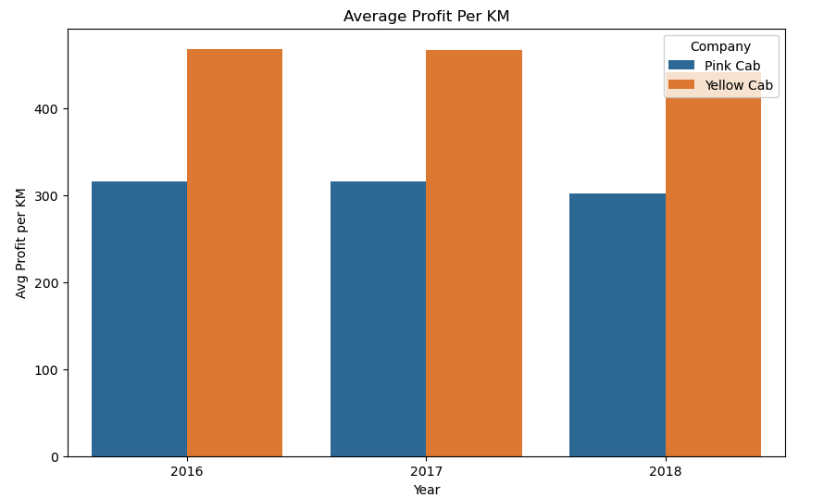
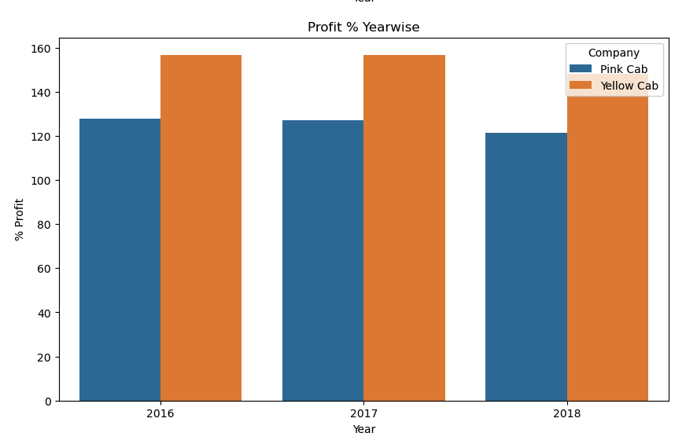
Profit Analysis
For the year 2016, the average profit per kilometre for Pink Cabs is lower than that for Yellow Cabs.
In 2017, the average profit per kilometre remains the same for Pink Cabs, while it is still higher for Yellow Cabs compared to Pink Cabs.
For 2018, the trend remains the same: Pink Cabs have a lower average profit per kilometre compared to Yellow Cabs.
Yellow Cabs consistently have higher average profit per kilometre and profit percentages compared to Pink Cabs across all three years.
Pink Cabs have shown a slight improvement in profit percentage by 2018 but still lag behind Yellow Cabs.

Slide 6
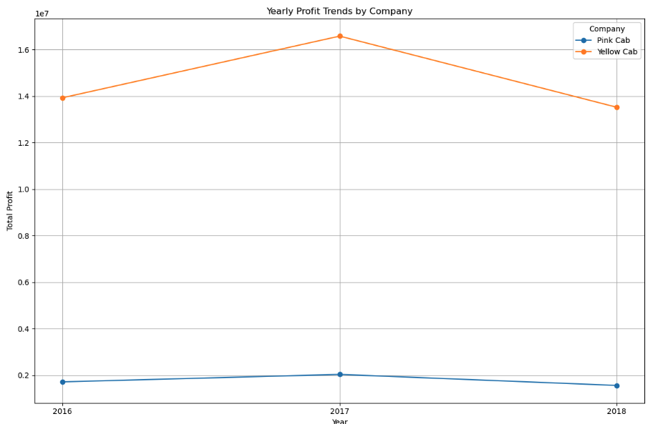
Yearly profit trends
Yellow Cabs consistently have higher yearly profits compared to Pink Cabs.
Yellow Cabs saw a peak in profit in 2017, followed by a slight decline in 2018, but the profit remained higher than in 2016.
Pink Cabs have much lower profits overall, with a slight peak in 2017 followed by a decrease in 2018.
The trends suggest that while Yellow Cabs experience fluctuations in profit, their overall performance is substantially better than that of Pink Cabs.

Slide 7
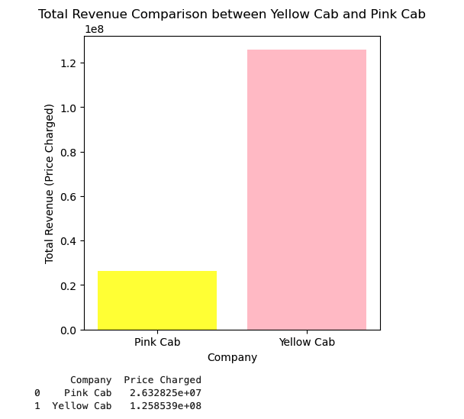
Total Revenue Comparison between Yellow Cab and Pink Cab
Yellow Cab generates a total revenue that is substantially higher than Pink Cab.
Specifically, Yellow Cab's total revenue is over six times greater than that of Pink Cab.
This comparison highlights a significant disparity in revenue generation between the two companies, with Yellow Cab leading by a large margin.

Slide 8
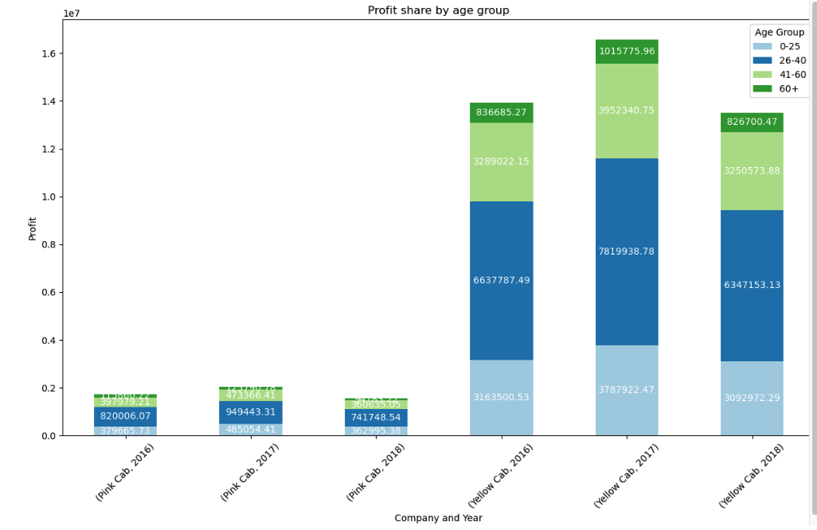
Profit share by age group
Pink Cab has consistently lower profits compared to Yellow Cab across all years and age groups.
For both companies, the age group 26-40 is the largest contributor to profits.
Yellow Cab's profit peaks in 2017 and decreases slightly in 2018 but remains significantly higher than that of Pink Cab.
The overall trend shows that Yellow Cab is more profitable and has a larger customer base contributing to its profits across different age groups compared to Pink Cab.

Slide 9
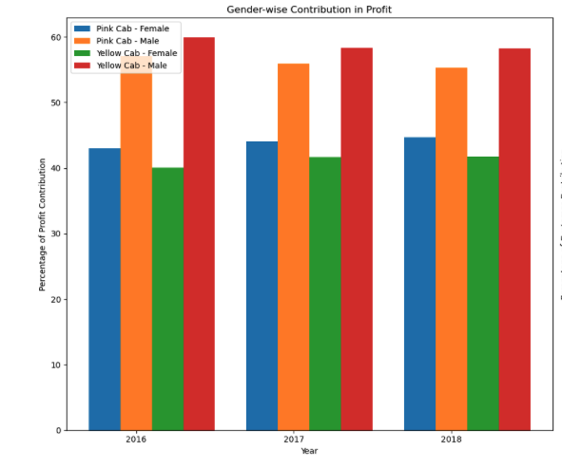
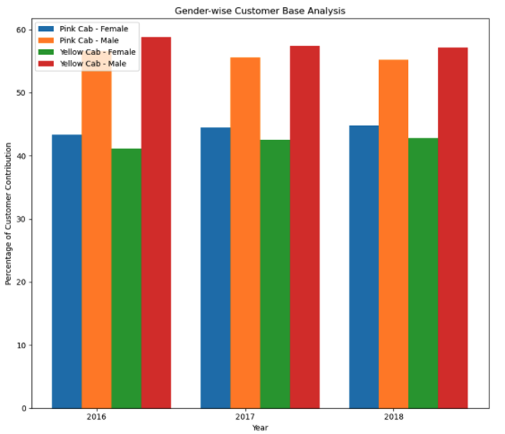
Profit and customer base Analysis Gender wise
Both graphs indicate a higher male contribution in terms of both profit and customer base for both Pink Cab and Yellow Cab.
Yellow Cab shows a more pronounced male dominance in both profit contribution and customer base compared to Pink Cab.
The data reflects a consistent trend over the three years (2016-2018) with minor variations.

Slide 10
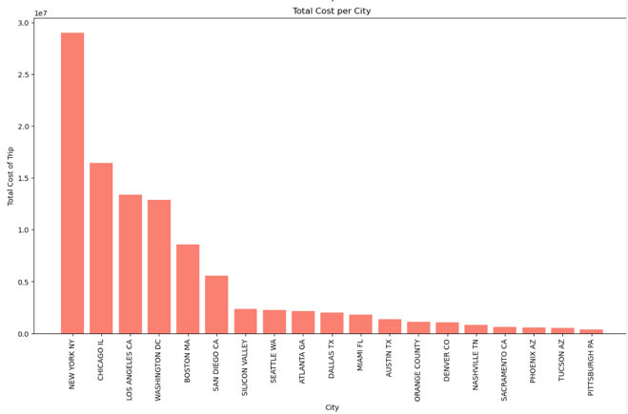
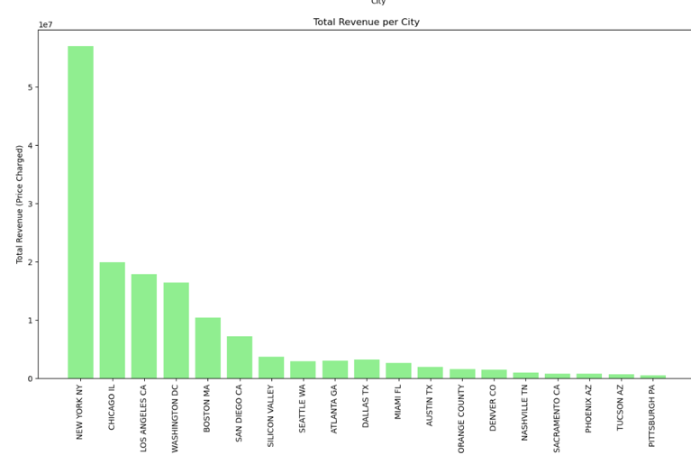
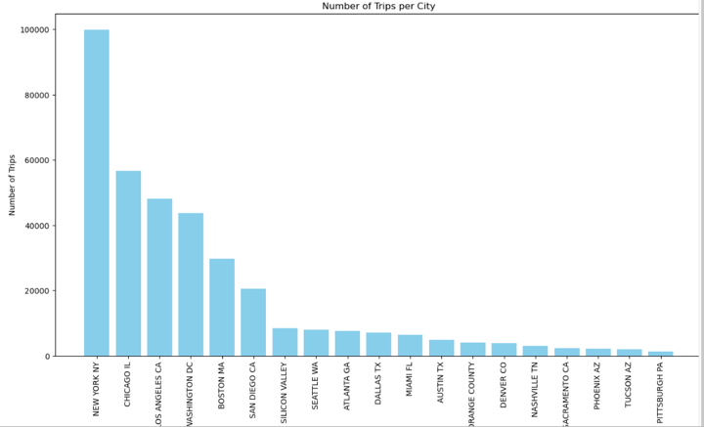
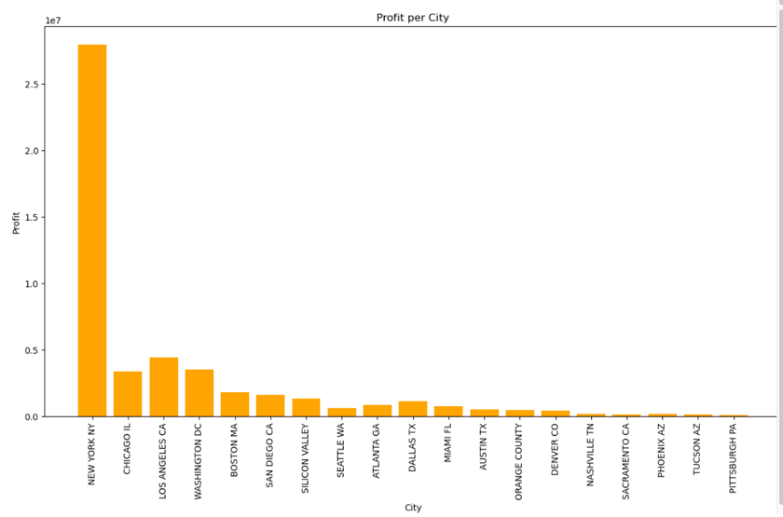
Per City Analysis
New York consistently leads across all metrics: total cost, total revenue, number of trips, and profit, indicating it is the most active and profitable city for the cab services.
Chicago and Los Angeles follow as significant contributors across all metrics, though they trail behind New York.
San Francisco, Boston, and Washington also play important roles, contributing substantial numbers in cost, revenue, trips, and profit.
The trends in these graphs suggest that the highest activity and profitability are concentrated in major metropolitan areas, with a steep decline in smaller or less busy cities.

Slide 11
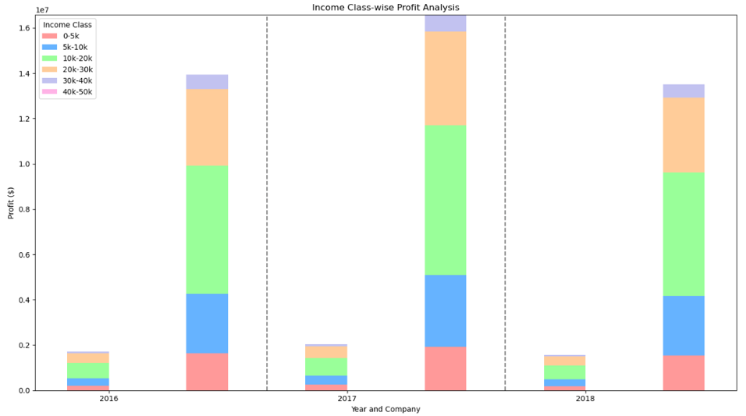
Income class wise profit analysis
Yellow Cab consistently shows higher profits across all years compared to Pink Cab.
Yellow Cab’s profits have significant contributions from higher income classes, particularly in 2017 where the profit peaks.
Pink Cab’s profits are much lower and show a relatively balanced contribution across all income classes.
The trend indicates that higher income classes contribute more significantly to Yellow Cab’s profits, highlighting the company’s stronger market presence and customer base in these income segments.

Slide 12
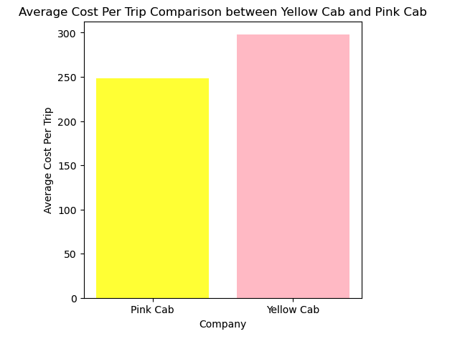
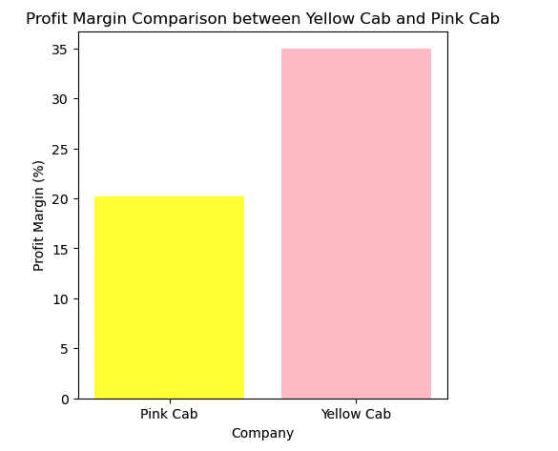
Average cost per trip and profit margin comparison
Yellow Cab not only charges a higher average cost per trip but also maintains a higher profit margin compared to Pink Cab.
These factors contribute to Yellow Cab's overall better financial performance compared to Pink Cab.

Slide 13
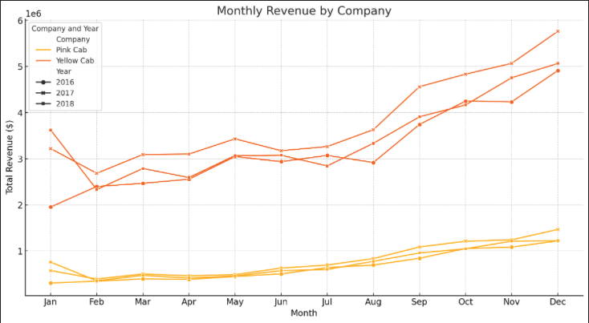
Monthly revenue by company

Slide 14
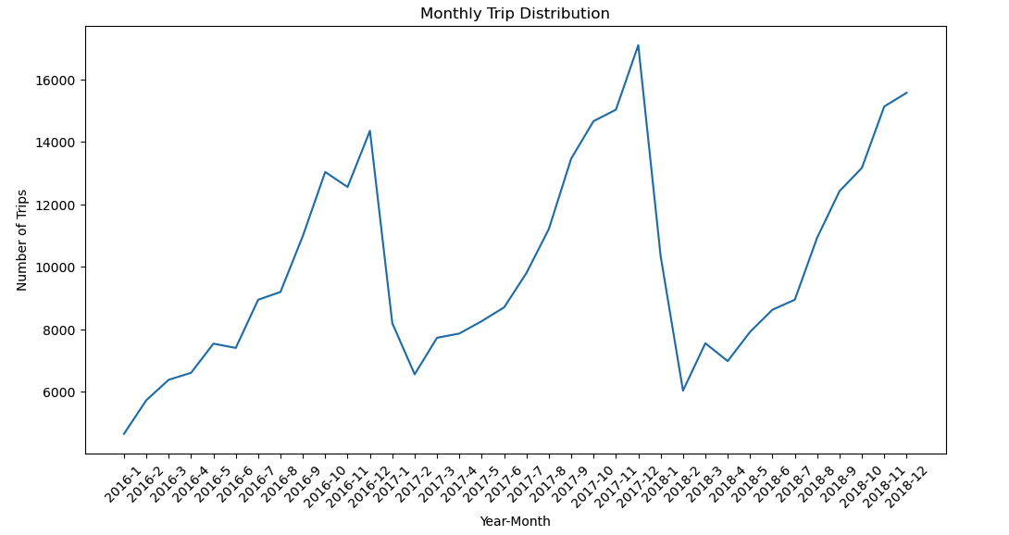
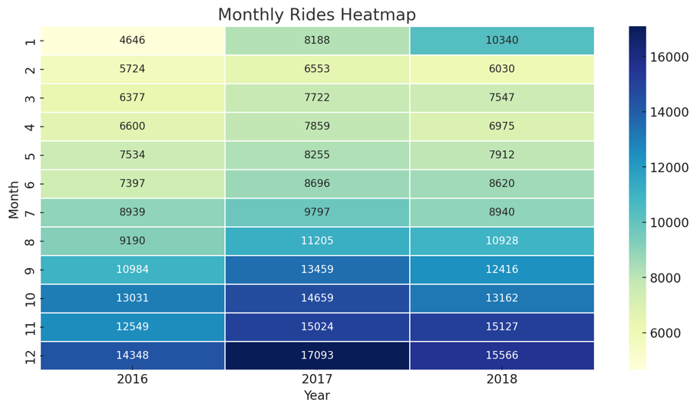
Monthly trip distribution

Slide 15
Recommendations
Recommendations for Pink Cab:
Consider reviewing and adjusting the pricing strategy to gradually increase the average cost per trip. This should be done carefully to avoid losing price-sensitive customers but can help improve revenue and profit margins.
Develop marketing strategies aimed at attracting higher income classes. This can be achieved through premium services, loyalty programs, and partnerships with businesses that cater to higher income individuals.
Analyse operational costs and identify areas where efficiency can be improved. This could involve optimizing routes, reducing fuel consumption, and managing maintenance costs more effectively.
Focus on expanding operations and improving service quality in key cities such as New York, Chicago, and Los Angeles, where the potential for higher revenue and profit is greater.
Recommendations for Yellow Cab:
While Yellow Cab already has a higher average cost per trip, it’s important to maintain competitive pricing. Regularly review pricing strategies to ensure they are aligned with market trends and customer expectations.
Focus on cost optimization to further improve profit margins. This can include better fleet management, reducing idle times, and leveraging economies of scale in procurement.
Implement or enhance loyalty programs to reward frequent customers. This can include discounts, free rides after a certain number of trips, and exclusive offers for loyal customers.

Slide 16
Thank You

